Slide 1
Currently, when the number of total analysis spectra exceeds the order of thousands, GUI-RITS may crash before execution is complete. This is most likely a problem with the Windows version of Python, but the cause has not yet been identified.
Therefore, we recommend using GUI-RITS for initial investigation of profile parameters and structural models up to the order of hundreds spectra, and then using a CLI-based exe version for fitting larger numbers of spectra.
The CLI-RITS exe file corresponds to GUI-RITS as follows.
rietveldcc.exe: RITS Fit of GUI-RITS
rietveldcc2.exe: RITS2 Fit of GUI-RITS
rietveldcc0.exe: RITS Simulation for cross section
edgecc.exe: EDGE Fit of GUI-RITS
edgecc2.exe: EDGE2 Fit of GUI-RITS

Slide 2
GUI-RITS
EDGE
RITS
RITS Simulation
Analysis of one data
Analysis of one data
Spectrum creation based on initial input values
EDGE2
RITS2
Analysis of many data
Analysis of many data
CLI-RITS
edgecc.exe
rietveldcc.exe
rietveldcc0.exe
edgecc2.exe
or edgecc2.o
rietveldcc2.exe
edgecc2.exe program may crash silently when fitting more than thousands spectra. In that case, please use edgecc2.o program.
Notes:
GUI-RITSのパッケージにはこれらのプログラムが含まれています。
シングルエッジフィットを行うEDGEプログラム、フルパターンフィットを行うRITSプログラム、
これらを多数のスペクトルに対して行うEDGE2及びRITS2プログラム、
また、本日の説明では割愛しますが、シミュレーションパターンを生成するRITSシミュレーションです。

Slide 3
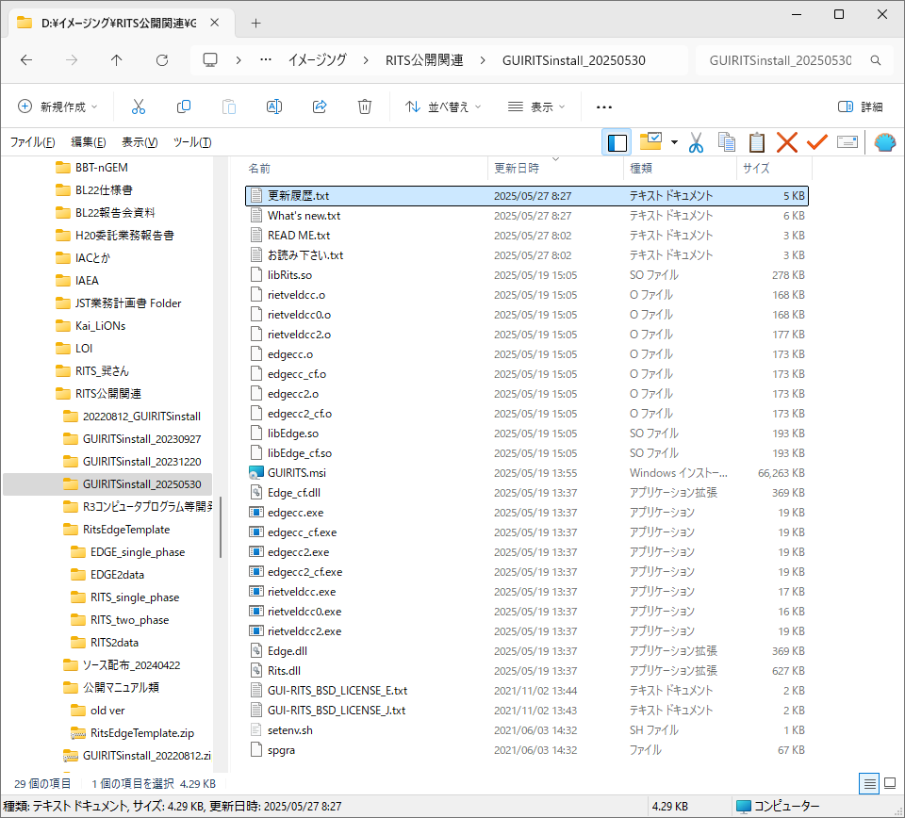
It is located in the folder created by unzipping the compressed file "GUI-RITS.zip" with password.
The usage of *.exe and *.o is almost the same. See later description.
CLI-RITS(gcc)
CLI-RITS(MSVC)
CLI-RITS(common)
Notes:
Zipファイルを解凍してできたGUI-RITS.msiをダブルクリックします。

Slide 4
Environment preparation for CLI-RITS execution
Windows11.
It will work on Home, but we are testing on Pro.
WSL1 and Ubuntu 22.04 LTS with Python 3.10.
File I/O seems to be slightly slower in WSL2.
Ubuntu 24.04 LTS will probably work.
If you need Python 3.11/3.12 version, contact us.
Details of how to install WSL and Ubuntu vary slightly depending on the version of windows, so please google the method that fits your system information.
You can leave 2-byte language environment as it is.
The exe/o files can be copied and pasted on Explorer as usual, so no installation work is required on Ubuntu.
We do not recommend (and do not support) using the command line to bring the exe files to a directory that only exists in WSL, as this may cause problems later.

Slide 5
For the purpose of analysis with CLI-RITS/EDGE, the following directory structure is assumed as an example.
In reality, there may be more miscellaneous "directories" and "files", but only the parts in red should be followed (fixed in the program).
『GUI-RITS』
『RitsEdgeTemplate』
『EDGE_single_phase』
「Tadahiro_5x6x20_00000.dat」
『EDGE2data』
『ABC』
『RITS_single_phase』
「Tadahiro_5x6x20_00001.dat」
『xyz』
『RITS_two_phase』
『RITS2data』
『pictures』
「EDGE2_Tadahiro.sh」
「edgecc2.exe」
「experiment conditions」
「Edge.dll」
「Tadahiro_5x6x20_00025.dat」
「rietveldcc2.exe」
Copy and paste from the unzipped "GUIRITSinstall" folder to here.
「Rits.dll」
「Tadahiro_5x6x20_position_XY.txt」
「RITS2_Tadahiro.sh」
「Tadahiro_5x6x20mask.txt」
「spgra」
「Tadahiro_EDGE.inp」
「edgecc2.o」
Move one directory up for convenience.
「libEdge.so」
「setenv.sh」
「Tadahiro_5x6x20mask.txt」
「Tadahiro_EDGE.inp」
「Tadahiro_5x6x40mask.txt」
「Tadahiro_RITS.inp」

Slide 6
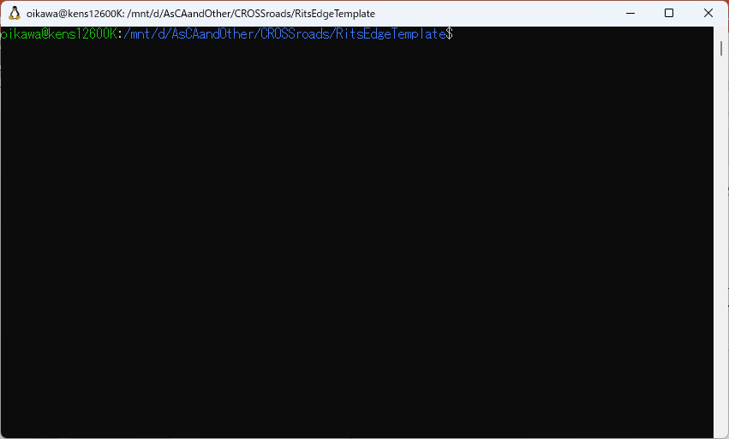
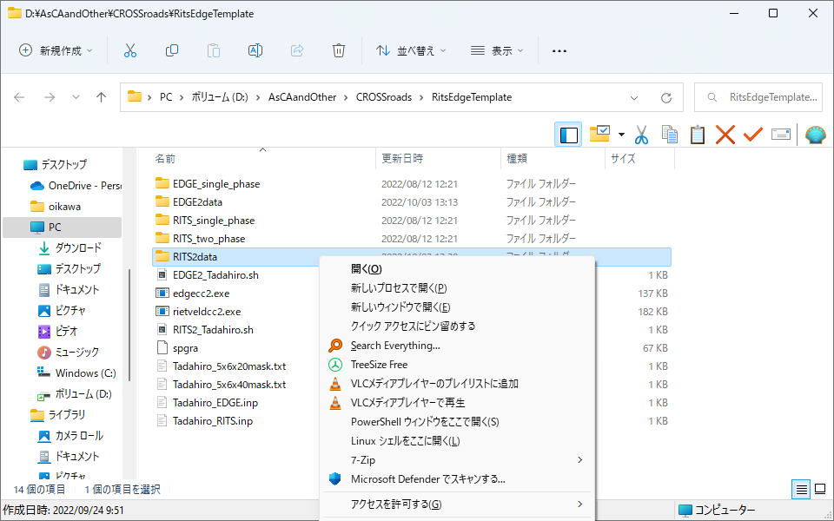
Open Linux shell
Open an Ubuntu terminal from the desired directory (e.g., "RitsEdgeTemplate") as shown below.
You can jump to the target directory in one shot.
(Sorry in Japanese).

Slide 7
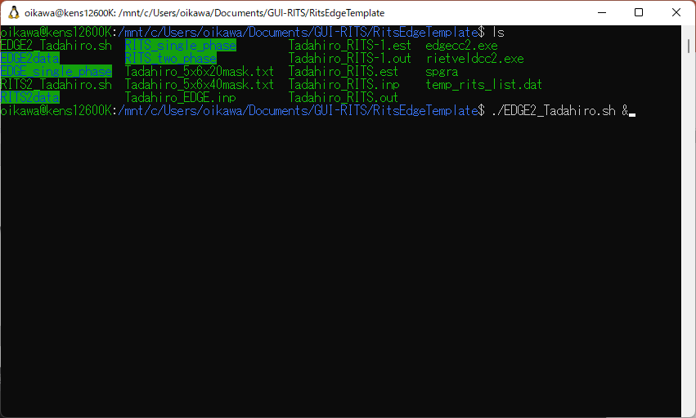
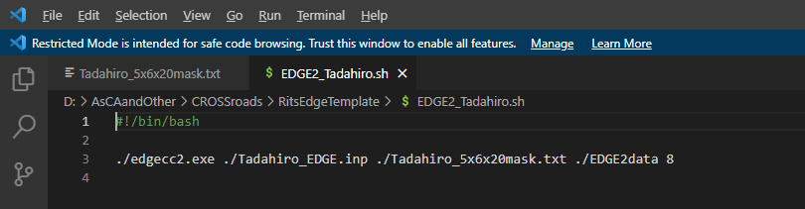
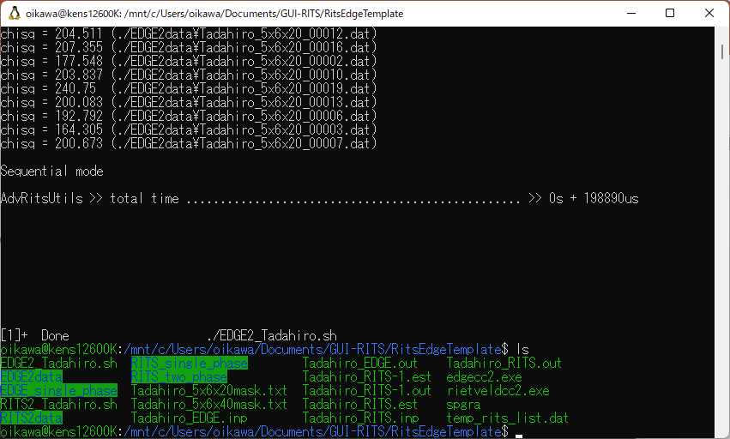
Assuming you are currently in "RitsEdgeTemplate“ in the terminal, type
$ . /EDGE2_Tadahiro.sh & ⏎
and execute the script "EDGE2_Tadahiro.sh".
The contents of "EDGE2_Tadahiro.sh" is a script that executes EDGE2 with 8 threads.
#! /bin/bash
. /edgecc2.exe . /Tadahiro_EDGE.inp . /Tadahiro_5x6x20mask.txt . /EDGE2data 8
. and so on.
Below is what the terminal looked like when the analysis was finished after about 0.2 second.
Tadahiro_EDGE.out is the output file.
Command
Arguments
Analysis result file

Slide 8
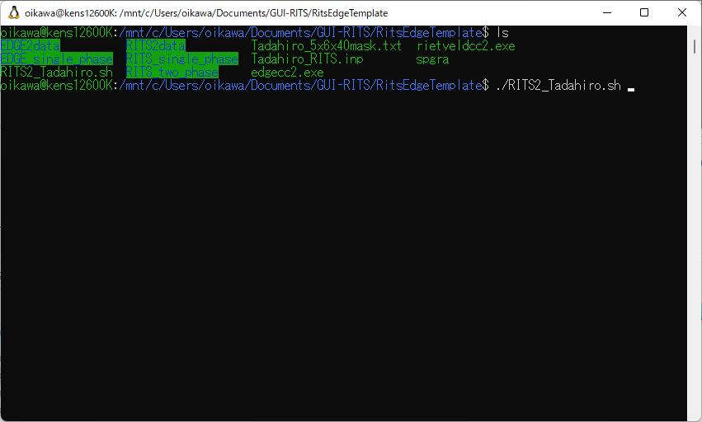
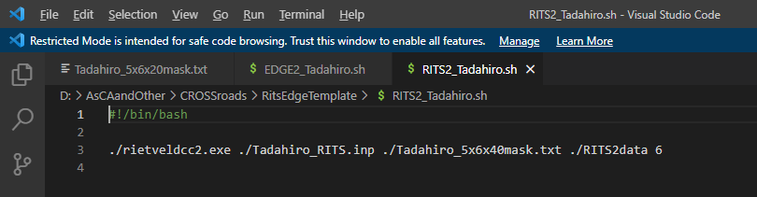
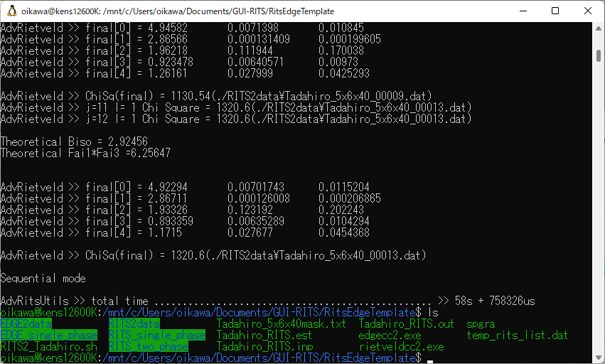
Assuming you are currently in "RitsEdgeTemplate“ in the terminal, type
$ . /RITS2_Tadahiro.sh & ⏎
and execute the script “RITS2_Tadahiro.sh".
The contents of “RITS2_Tadahiro.sh" is a script that executes RITS2 with 6 threads.
#! /bin/bash
. /rietveldcc2.exe . /Tadahiro_RITS.inp . /Tadahiro_5x6x40mask.txt . /RITS2data 6
. and so on.
Below is what the terminal looked like when the analysis was finished after about 1 minute.
Tadahiro_RITS.out and Tadahiro_RITS.est are the output file.
Command
Arguments
List of estimated values of σt
Analysis result file

Slide 9
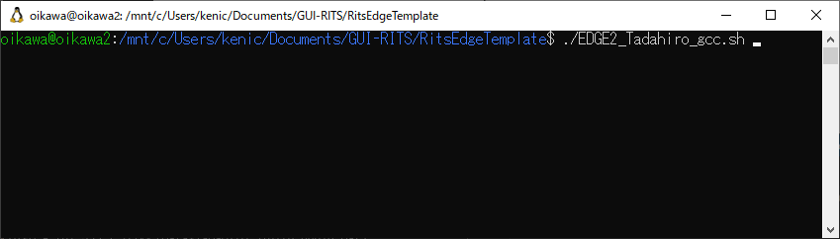
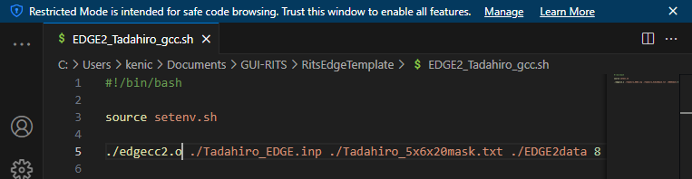
Assuming you are currently in "RitsEdgeTemplate“ in the terminal, type
$ . /EDGE2_Tadahiro_gcc.sh⏎
and execute the script "EDGE2_Tadahiro_gcc.sh".
The contents of "EDGE2_Tadahiro.sh" is a script that executes EDGE2 with 8 threads.
#! /bin/bash
source setenv.sh
. /edgecc2.o . /Tadahiro_EDGE.inp . /Tadahiro_5x6x20mask.txt . /EDGE2data 8
. and so on.
Below is what the terminal looked like when the analysis was finished after about 0.2 second.
Tadahiro_EDGE.out is the output file.
Command
Arguments
The script "RITS2_Tadahiro_gcc.sh" can be used for rietveldcc2.o, but in our experience rietveldcc2.exe has never crashed and rietveldcc2.exe is clearly faster to run, so I we don't think we will ever use rietveldcc2.o.
Analysis result file

Slide 10
Other tips and examples
『Sukemasa』
『GEM003584』
『RITS2data』
「index_0.dat」
『GEM003585』
『EDGE2data』
「index_1.dat」
「GEM003584.tiff」
『GEM003586』
「RITS2mask.txt」
『some pictures』
「EDGE2mask.txt」
「Condition.docx」
「Suke_rits1.inp」
「Suke_rits2.inp」
Initial parameter file(s) for RITS (or EDGE) saved by GUI-RITS panel.
「index_16383.dat」
「Suke_rits3.inp」
「Suke3584.sh」
「ROI_memo.txt」
「RITS2.exe」
This is the file of symmetry operation used in RITS(2), abbreviation of SpaceGroup vol.A.
Only the files *.dat are read by RITS2.exe/EDGE2.exe, so you can leave notes, etc. in the directory.
「spgra」
「EDGE2.exe」

Slide 11
Shell Script Examples (1)
『Sukemasa』
『GEM003584』
『RITS2data』
Assuming that you are currently at “GEM003584”, from the Ubuntu terminal,
$ ./Suke3584.sh & ⏎
To execute the script “Suke3584.sh”.
You may write a path to "Suke3584.sh" from any location, but this depends on your style/skill. However, in that case, the Japanese path may not pass (it was not possible in my environment).
The contents of "Suke3584.sh" are, if you want to run RITS2 using 8 threds,
#!/bin/bash
./rietveldcc2.exe ./Suke_rits1.inp ./RITS2mask.txt ./RITS2data 8
./rietveldcc2.exe ./Suke_rits2.inp ./RITS2mask.txt ./RITS2data 8
./rietveldcc2.exe ./Suke_rits3.inp ./RITS2mask.txt ./RITS2data 8
If you want to run EDGE2, change rietveldcc2.exe to edgecc2.exe and specify the *.inp file for EDGE.
In most cases, the mask file should be the same, but if you have several samples, you can use separate files for each area (see image on next page).
『EDGE2data』
「GEM003584.tiff」
「RITS2mask.txt」
「EDGE2mask.txt」
「Suke_rits1.inp」
「Suke_rits2.inp」
「Suke_rits3.inp」
「Suke3584.sh」
「RITS2.exe」
「spgra」

Slide 12
For example, suppose that three samples of different elementary characteristics (with very different initial value files) are measured at the same time.
You can prepare a folder "RITS2data" of spectra for each data area, but this name cannot be changed in CLI-RITS, so it becomes complicated.
sample1
sample2
sample3
In such case, "RITS2data" is assumed to contain data from all regions, and only the area containing sample 1 is flagged 1 for analysis, and all other areas are excluded from analysis (flag 0) in the file "RITSmask1.txt". Prepare "RITSmask2.txt" with only sample 2 flagged 1, "RITSmask3.txt" with only sample 3 flagged 1, as well.
Then you can analyze by
#!/bin/bash
./rietveldcc2.exe ./Suke_rits1.inp ./RITSmask1.txt ./RITS2data 8
./rietveldcc2.exe ./Suke_rits2.inp ./RITSmask2.txt ./RITS2data 8
./rietveldcc2.exe ./Suke_rits3.inp ./RITSmask3.txt ./RITS2data 8

Slide 13
output file Examples (1)
『Sukemasa』
『GEM003584』
『RITS2data』
When "Suke3584.sh" is executed with the contents of the previous page, following files will be created in the directory containing rietveldcc2.exe.
Suke_rits1.out, Suke_rits1.est, Suke_rits2.out, Suke_rits2.est, Suke_rits3.out, and Suke_rits3.est.
In other words, xyz.out is created with the xyz part of xyz.inp. xyz.est is the file for the automatic estimation of atomic number density, but if you don't use it, don’t care about it.
If the file name already exists, the file name is automatically appended with -1, -2, etc. (without overwriting).
Similarly, if you run the program with EDGE2, following files will be created in the directory containing edgecc2.exe.
Suke_rits1.out, Suke_rits2.out and Suke_rits3.out.
『EDGE2data』
「GEM003584.tiff」
「RITS2mask.txt」
「EDGE2mask.txt」
「Suke_rits1.inp」
「Suke_rits2.inp」
「Suke_rits3.inp」
「Suke3584.sh」
「RITS2.exe」
「spgra」

Slide 14
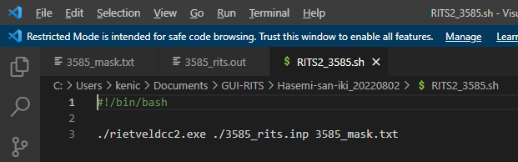
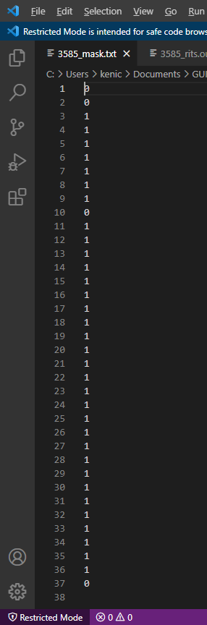
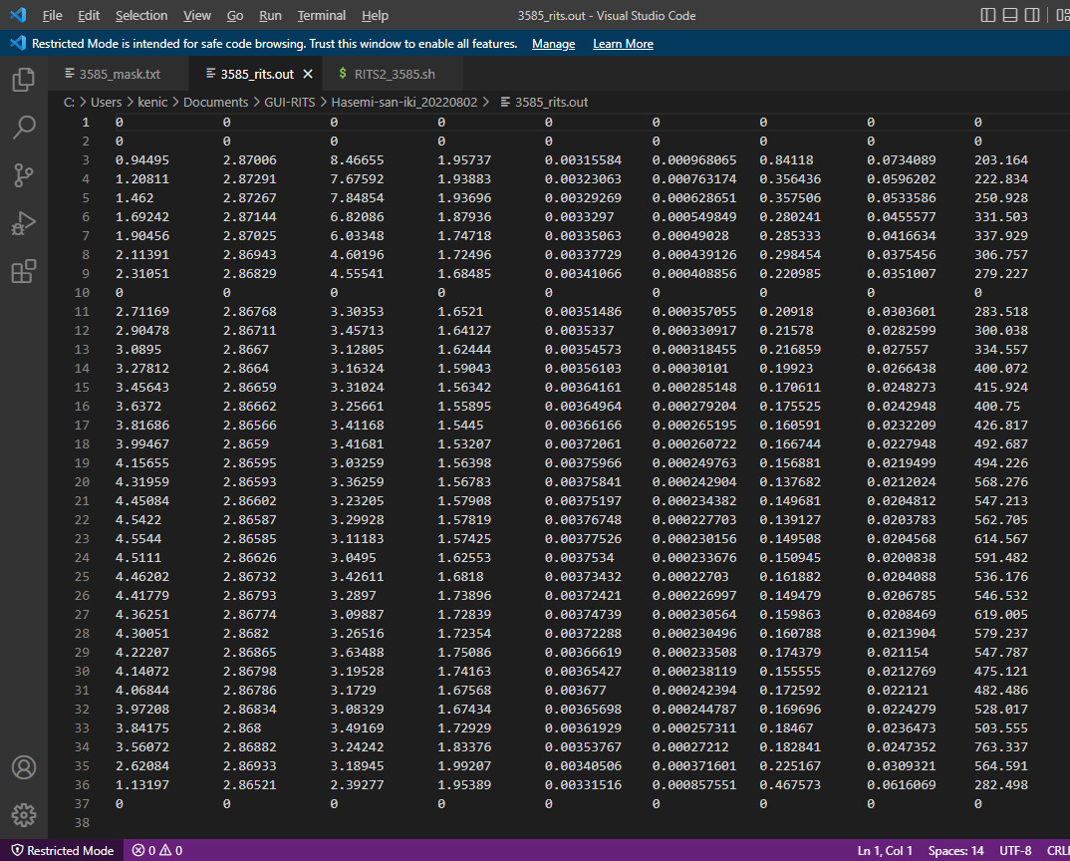
Examples of a mask file and an output file
In this example, 37 data are in the “RITS2data" folder, and nos. 1, 2, 10 and 37 are specified in the mask file "3585_mask.txt" as an analysis exclusion.
Contents of the .out file. Nos. 1, 20, 10 and 37 are not analyzed.

Slide 15
Shell Script Examples (2)
『Sukemasa』
『GEM003584』
『RITS2data』
If you want to analyze a spectrum one by one with rietveldcc.exe, the contents of "Suke3584.sh" should be
#!/bin/bash
./rietveldcc.exe ./Suke_rits1.inp ./path/index_A.dat
mv ./fit_func.dat ./Suke_rits1.fit
mv ./fit_para.dat ./Suke_rits1.par
./rietveldcc.exe ./Suke_rits2.inp ./path/index_B.dat
mv ./fit_func.dat ./Suke_rits2.fit
mv ./fit_para.dat ./Suke_rits2.par
./rietveldcc.exe ./Suke_rits3.inp ./path/index_AB.dat
mv ./fit_func.dat ./Suke_rits3.fit
mv ./fit_para.dat ./Suke_rits3.par
and so on.
In short, instead of needing a mask file, specify the spectral files one by one.
Also, since the output file names are fixed to fit_func.dat and fit_para.dat, rename them with the mv command. (If you do not mv them, they will be overwritten.)
If you want to run EDGE, change rietveldcc.exe to edgecc.exe and specify the initial value file for EDGE.
『EDGE2data』
「GEM003584.tiff」
「RITS2mask.txt」
「EDGE2mask.txt」
「Suke_rits1.inp」
「Suke_rits2.inp」
「Suke_rits3.inp」
「Suke3584.sh」
「RITS2.exe」
「spgra」

Slide 16
Calculation speed
Regardless of the number of threads, rietveldcc2.exe is clearly faster than rietveldcc2.o.
Between edgecc2.exe and edgecc2.o, edgecc2.o is faster. Below is an example of the verification. Ryzen 5700G is a CPU with 8 cores and 16 threads.

Slide 17
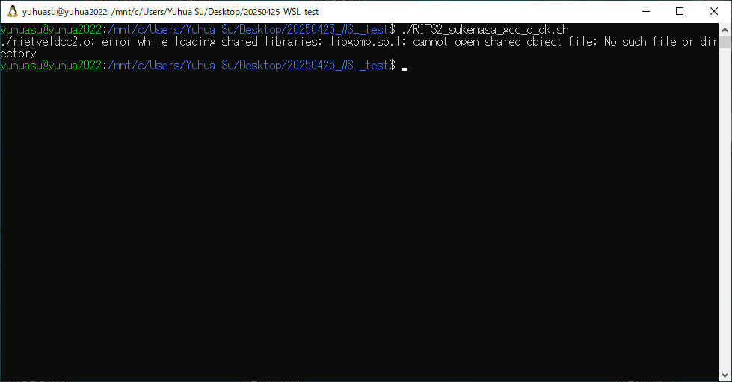
Potential errors in the GCC version of rietveldcc and edgecc
Sometimes the program fails to run, displaying an error that
error while loading shared libraries: libgomp.so.1: cannot open shared object file: No such file or directory
This message is literal, and in such cases, please enter the following command in your terminal:
$ sudo apt install libgomp1
This will install libgomp1, allowing the program to run properly.

